Slide 1
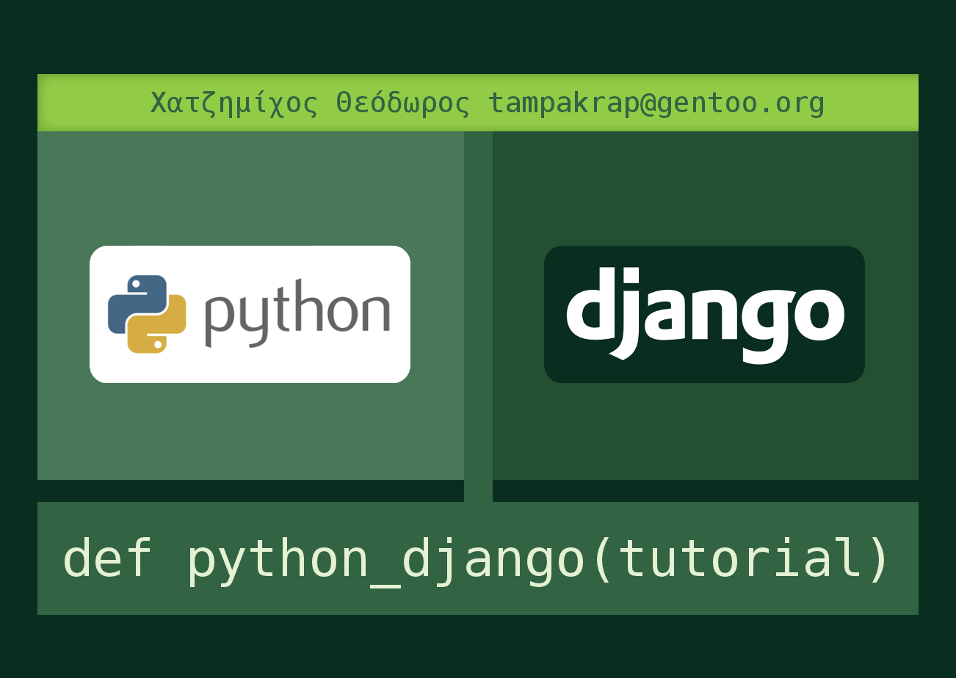
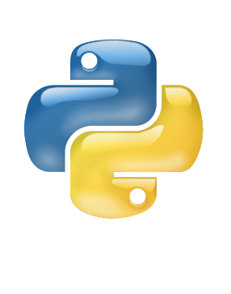
Title goes here
Point 1
  Subpoint 1
  Subpoint 2 emphasis
Point 2
Point 3
Point 4
Point 5
Code goes here

Slide 2
Python Introduction
ProgrammingLanguage
  Interpreted
  High Level
  Scripting
Easy to learn
  Perfect for beginners
Coding in:
  Python Shell
    Quick way to test code
  Python Scripts
Code goes here

Slide 3
Python Introduction
ProgrammingLanguage
  Interpreted
  High Level
  Scripting
Easy to learn
  Perfect for beginners
Coding in:
  Python Shell
    Quick way to test code
  Python Scripts
Code goes here

Slide 4
Data Structures
Integers
  Calculations
Strings
Lists
Tuples
Unicode
Convert Types
Dictionaries
>>> 5 + 5
10
>>> 2**3
8
>>> 7/-3
-3
>>> a = 1.5 + 3.5j
>>> type(a)
<type 'complex'>
>>> a = 'opensuse collaboration camp'
>>> print a[5:]
use collaboration camp
>>> languages = ['python', 'php', 'ruby']
>>> languages[2]
'ruby'
>>> languages.append('c++')
>>> languages
['python', 'php', 'ruby', 'c++']
>>> languages = tuple(languages)
>>> test = u'python'

Slide 5
Statements
While
If
For
Range
Break / Continue
for n in range(2, 10):
for x in range(2, n):
if n % x == 0:
print n, 'equals', x, '*', n/x
break
else:
# loop fell through without finding a factor
print n, 'is a prime number'
def fib(n):
"""Print a Fibonacci series up to n."""
a, b = 0, 1
while a < n:
print a,
a, b = b, a+b

Slide 6
Programming
Functions
Exceptions
Modules
Command line arguments
def ask_ok(prompt, retries=4,complaint='Yes or no, please!'):
while True:
ok = raw_input(prompt)
if ok in ('y', 'ye', 'yes'):
return True
if ok in ('n', 'no', 'nop', 'nope'):
return False
retries = retries - 1
if retries < 0:
raise IOError('refusenik user')
print complaint

Slide 7
PyQt4
Python Qt Bindings
  Really popular
  Even in embedded GUI apps
Example apps:
  Application Icon
  Quit Button
#!/usr/bin/python
# Application Icon
import sys
from PyQt4 import QtGui
app = QtGui.QApplication(sys.argv)
widget = QtGui.QWidget()
widget.resize(250, 150)
widget.setWindowTitle('test')
widget.show()
sys.exit(app.exec_())

Slide 8
Django
Web Framework
MVC
- Models
- Views
- Controllers
DRY
Modular (Unix philosophy
Used in major open source projects' websites
Separate webdev from webdesign work
Useful commands:
django-admin.py startproject 'opensuse_camp'
python manage.py startapp
python manage.py syncdb
python manage.py sqlall
python manage.py runserver (optional: <ip> <port>)

